Slide 1


DATA ANALYSIS
Notes:
Hello and welcome, my name is Ujjwal, and I will be presenting the outcomes of the Data Analytics job to you today.

Slide 2


Today's agenda
Project recap
Problem
The Analytics team
Process
Insights
Summary
Notes:
The following items will be on today's agenda:
1. We will summarise the whole project to provide a high-level knowledge of the business problem and the specific requirements.
2. We will go over the exact problem that we, the Data Analytics team, have been working on and explain why it is such a major deal.
3. After outlining the situation, I will go over the team responsible for completing this assignment from our end.
4. I will then go into the high-level process that we used to finish this assignment so that you understand exactly how we approach this kind of task.
5. Finally, I will go over the key findings and present them as a series of insights and visualizations based on our investigation.
To conclude, I will summarise and leave the floor open for questions.

Slide 3

Social Buzz is a rapidly expanding technology unicorn that must adjust quickly to its global scope.
Accenture has initiated a three-month proof-of-concept focusing on the following tasks:
An Examination of Social Buzz's big data practice
Recommendations for a Successful IPO
Analyze Social Buzz’s Top 5 most popular content categories
Project Recap
Notes:
Let me begin by recapping this engagement.
Accenture has begun a three-month trial with Social Buzz to focus on three primary tasks that are linked with some of the most pressing difficulties you are now facing.
In recent years, Social Buzz has grown to become known as a global unicorn firm. We are here to assist you in navigating this scale and pointing you in the proper route.
To begin, we will audit your big data practice and share best practices and industry knowledge. Second, we will guide you through a successful IPO, in which we have extensive expertise and knowledge. Finally, we analyzed your data to get insights into your top five most popular content categories.

Slide 4

Problem
Every day, about 100,000 posts are made.
Every year, 36,500,000 pieces of material are created!
But how do you capitalize on it when there's so much of it?
An examination of the top five most popular content categories on Social Buzz.
Notes:
Focusing on the last item I said, this is what the Data Analytics team has been concentrating on.
Obviously, with such grandiose scale comes a lot of data, and with such large volumes of data comes issues.
To give you an idea of how much data you've been producing: - You told us that your platform receives over 100,000 posts each day, for a total of 36,500,000 posts per year, all of which is unstructured data that is difficult to understand.
In this day and age, content reigns supreme. Consider some of the world's largest platforms, such as YouTube, Facebook, and Netflix... they are all content businesses...
But how do you capitalise on it when there's so much of it?
It's not only a matter of gathering as much content as possible... The true value comes from analysing and processing this content in order to obtain a deeper understanding of your audience and so create a more personalised and entertaining experience.
And this is where our data analytics experience comes in; using the insights gained from this assignment, we can show you exactly how to grow analytics.

Slide 5



ANDREW FLEMING
Chief Technology Architect
The Analytics team
MARCUS ROMPTON
Senior Principal
UJJWAL SRIVASTAVA
Data Analyst
Notes:
In terms of experience, Accenture has a significant data analytics practice, but we only had a team of three employees primarily focused on this assignment. Our Chief Technical Architect, Andrew Fleming, was instrumental in guiding the team to provide high-quality analysis.
Marcus Rompton, a senior data expert, has solved data challenges for some of the world's largest companies and was actively involved in the data engineering side of this project.
Finally, I, Ujjwal, was entirely accountable for taking leadership direction and generating high-quality insights from raw datasets, which were then translated into business choices.

Slide 6
Process
1
Data Understanding
2
Data Cleaning
3
Data Modelling
4
Data Analysis
5
Uncover Insights
Notes:
So, how did we approach this issue? We approached it in five steps :
Data comprehension - Understanding the data in depth is critical to the success of any data endeavor. As a result, we spent time learning about your company's data model and domain.
Data extraction - after learning about your company, we designed an ideal dataset for this challenge and extracted it from the necessary data sources.
Following the extraction of raw data, we needed to filter and model this data into a dataset capable of precisely answering business queries and producing analytics.
We used our analytical capabilities to identify insights from our new dataset and to create visualizations to describe the insights.
Finally, we applied these insights to create business decisions and recommendations for the next steps.

Slide 7

Insights
>1500
Reactions to “Food” posts
January
Month with
most posts
16
Unique Categories
Notes:
We discovered that you had a total of 16 distinct types of posts across your sample dataset based on your data. This encompasses topics like food, culture, and sports.
In addition, there were more than 1500 posts in the Food category alone! People clearly enjoy eating!
Also, January was the most popular month for users to post in; considering this is such a seasonal month with so many holidays and activities, it's interesting to know that people are most active during this month!
But now for the major question... what were the top five most popular article categories?

Slide 8
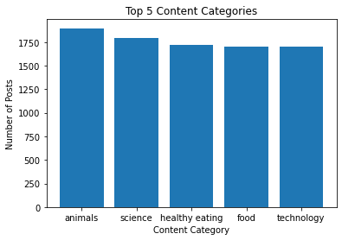
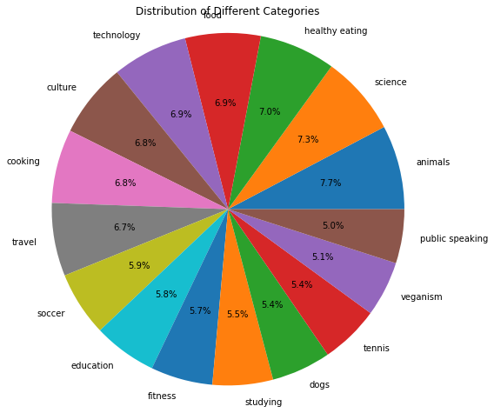

Slide 9
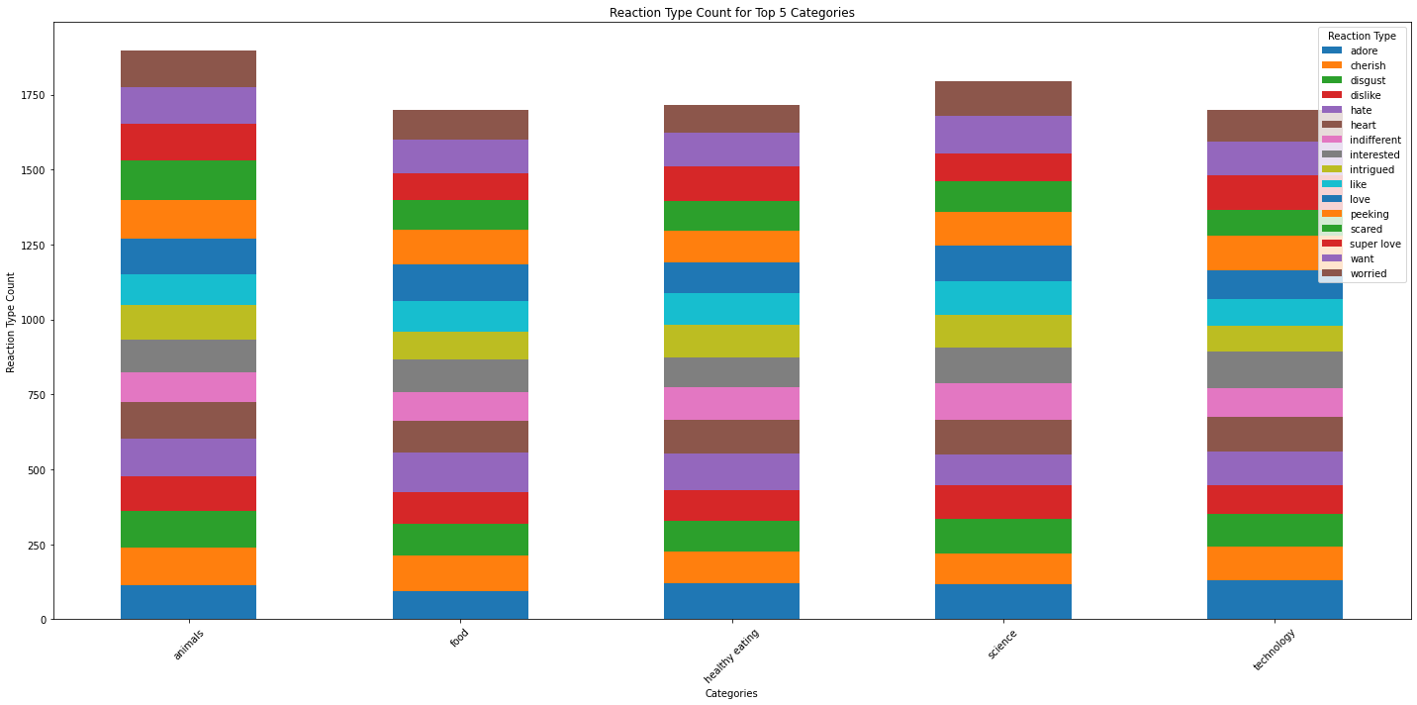

Slide 10
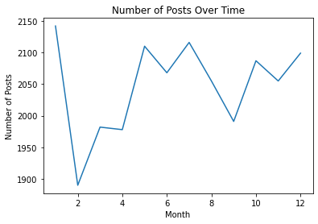

Slide 11

ANALYSIS
Science and animals are the most popular content categories, indicating that people choose "real-life" and "factual" material.
INSIGHT
Food is a recurring motif in the top five categories, with "Science" placing highest. This may provide insight to your user base's audience. You may utilize the information to develop a campaign and collaborate with healthy eating brands to increase user engagement.
Summary
UPCOMING STEPS
This ad hoc analysis is useful, but it's time to put it into large-scale production for a real-time understanding of your business. We can demonstrate how
Notes:
In conclusion:
We undertook this work and discovered the top five most popular categories, as requested, but we went one step further.
- We discovered that food and culture are the two most popular categories, indicating that consumers like "real-life" content.
We also discovered that football was the third most popular, maybe owing to the upcoming tournament.
This gives a huge chance for Social Buzz to capitalize on this worldwide event since all eyes will be on it as well as the participants.
As insightful as this study was, we are ready to take it to the next level, and Accenture knows to help you realize these kinds of insights in production across your organization and in real time. We would be delighted to assist you with this.

Slide 12
Thank you!
ANY QUESTIONS?
Notes:
Thank you very much for listening, please feel free to ask any questions that you may have!

